Slide 1


Slide 2


Hassiba Benbouali University of Chlef
Faculty of Exact Sciences and Computer Science Department of Computer Science
License Plate Detection and Recognition
PRESENTED BY :
ALI BEN YAHIA ILYAS.
ALLALI AYOUB.
FRAMED BY:
ZOUAOUI GUELLIL

Slide 3






problem
Object
Methodology
Results
Conclusion
Introduction
1
2
3
4
5
6

Slide 4
1
Introduction
2
License plate detection and recognition is the technology that use computer vision to detect and recognize a license plate from the camera or video or input image of a car.
3
4
5
6

Slide 5
1
License plate detection in varying conditions.
Accurate character recognition.
Real-time processing requirements.
Adaptability to diverse environments.
Privacy and security concerns.
2
problem
3
الكشف عن لوحة الترخيص في ظروف مختلفة. التعرف الدقيق على الأحرف. متطلبات المعالجة في الوقت الحقيقي. القدرة على التكيف مع البيئات المتنوعة. مخاوف الخصوصية والأمان.
4
5
6

Slide 6


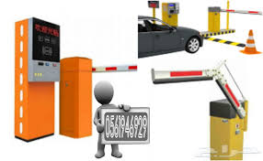

1
2
The primary goal of license plate detection and recognation systems is to provide accurate and efficent solutions for capturing and processing and using license plate information in applictions
3
Object
4
5
6

Slide 7


1
visual studio 2022 version
C++​
Library :​
OpenCV​
Tesseract_OCR
2
3
4
Methodology
5
6

Slide 8
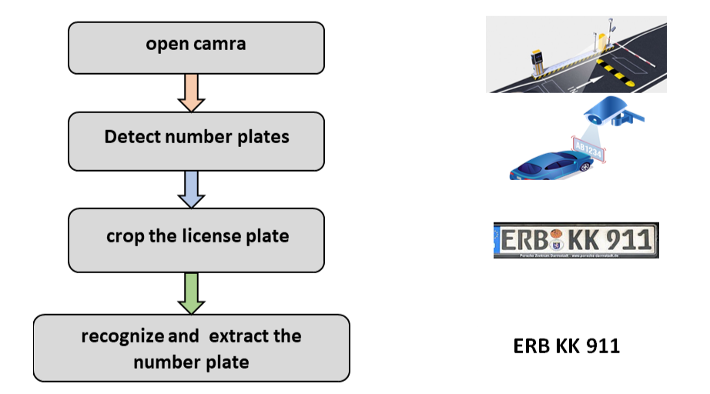
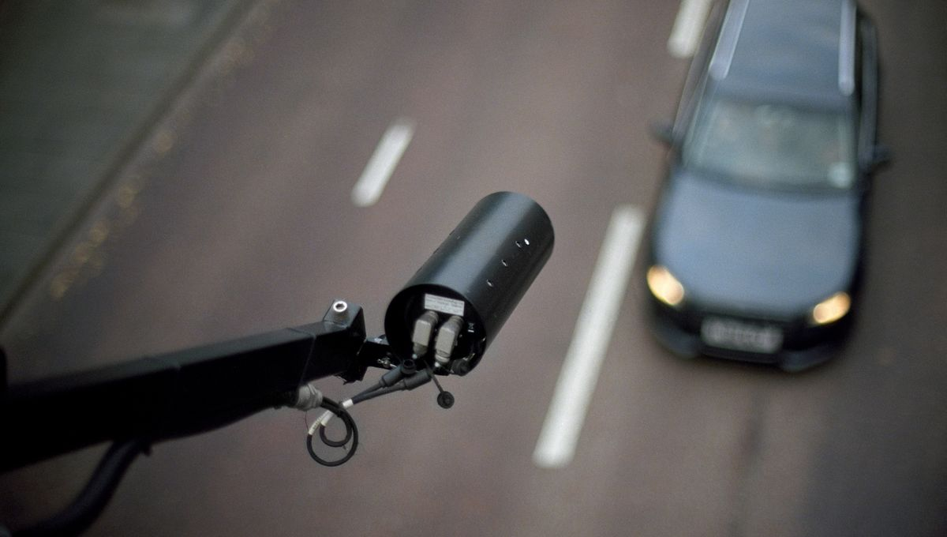
1
2
3
4
Methodology
5
6
To open the camera, you must use a function in the OpenCV library

Slide 9
1
2
3
4
Methodology
5
To detect vehicle number plates through the camera, we have used the Haar Cascade XML file which contains the features of Russian license plates .
6

Slide 10
1
2
3
4
Methodology
5
6
Cut and save the detected license plate

Slide 11

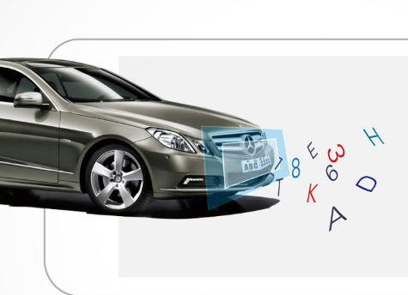
1
2
3
4
Methodology
5
We need to use the tesseract_OCR library to recognize text from a file
Image of the saved license plate that was detected
6

Slide 12

1
2
3
4
5
results
Program implementation
Code explanation
6

Slide 13
1
مكّن هذا المشروع من تطوير نظام وظيفي للكشف عن لوحات الترخيص والتعرف عليها باستخدام OpenCV و C ++. يتمتع هذا النظام بمزايا كبيرة في مجالات مثل المراقبة وإدارة المرور وسلامة الطرق. ومع ذلك ، هناك بعض المشاكل التي يواجهها ، بما في ذلك: • التقط لوحات الترخيص في ظل ظروف صعبة. • عوامل مثل الإضاءة والانسداد وظروف السيارة. • الاختلافات في أشكال لوحة الترخيص
2
3
this project made it possible to develop a functional system for the detection and recognition of license plates using OpenCV and C++. This system has significant advantages in areas such as surveillance, traffic management, and road safety.
However, there are some problems it faces, including:
• Pick up license plates under difficult conditions.
• Factors such as lighting, occlusion and vehicle conditions.
• Differences in license plate formats
4
5
6
Conclusion

Slide 14


